Slide 1
INCOME EVOLUTION IN THE ITALIAN LABOR MARKET
Breakdown of an Italian worker’s first wage, future jobs’ first wages and evolution of salary over time from 2005 to 2016
BISCIONE ELEONORA
CAMPO ORAZIO
COIANIZ IRENE
D’ERRICO ANTONIO MARCO

Slide 2

BACKGROUND
After WWII Italy went through a period of intense development like many other countries after the conflict. However, for the last 30 years its growth speed has slowed down. Indeed, average real wages in Italy have not grown in the years ranging from 1991 to 2021 (OECD).
POLITICAL REASON
LOSS OF YOUNG POTENTIAL
Italy has been characterized historically by instability at the political level and by an inefficient judgement system. Factors that hinder foreign investment
NEETs in Italy are 20% - more than double the average of OECD countries.
Given work expectations, Italian children are at elevated risk for underperforming in school or even dropping out of school.
ECONOMIC REASON
SOCIAL
Italy has been technologically and physically aging for some decades being unable to keep pace with the competitive global economy. Moreover, according to literature, higher productivity and wages are linked to firm size, Italy has a large share of small-medium firms
Italy’s human capital is lower in quality compared to other countries. Returns to education are relatively low in Italy as well as education in general.
Notes:
NEET : not looking for a job nor studying
OECD countries: The Organisation for Economic Co-operation and Development - intergovernmental organisation with 38 member countries, founded in 1961 to stimulate economic progress and world trade
Real wages did not grow in the past 30 yrs
3rd in unemployment rates in the EU
1st in NEETs rates in the EU
Italy has small-medium sized firms with family-styled management

Slide 3
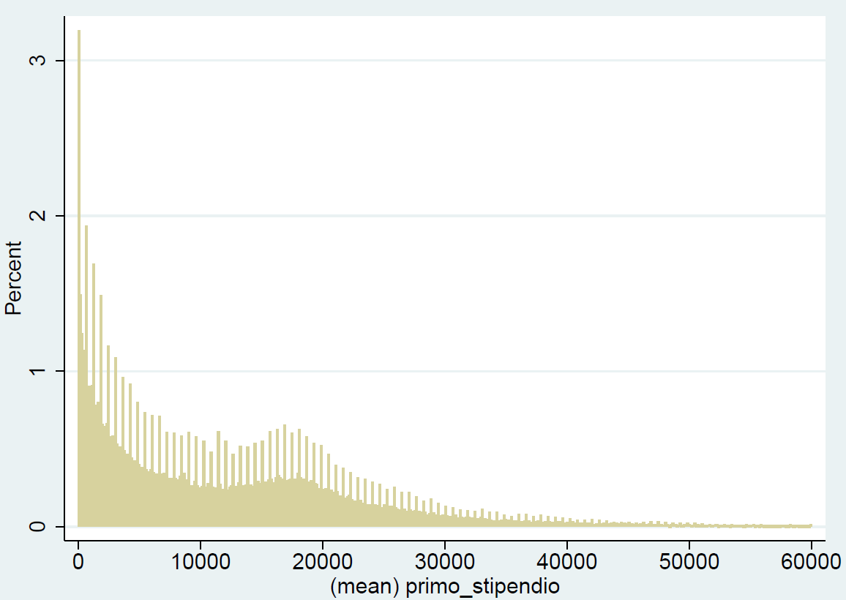
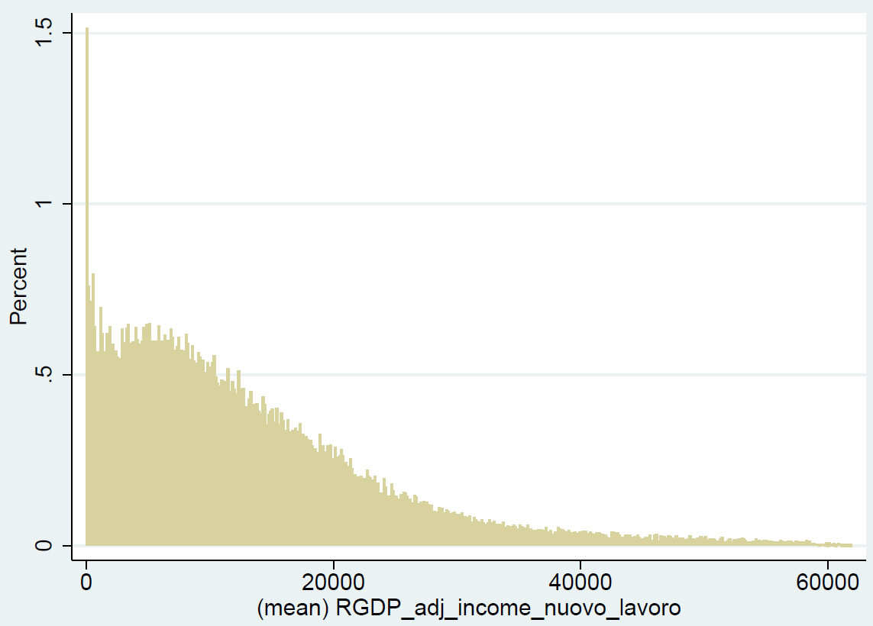
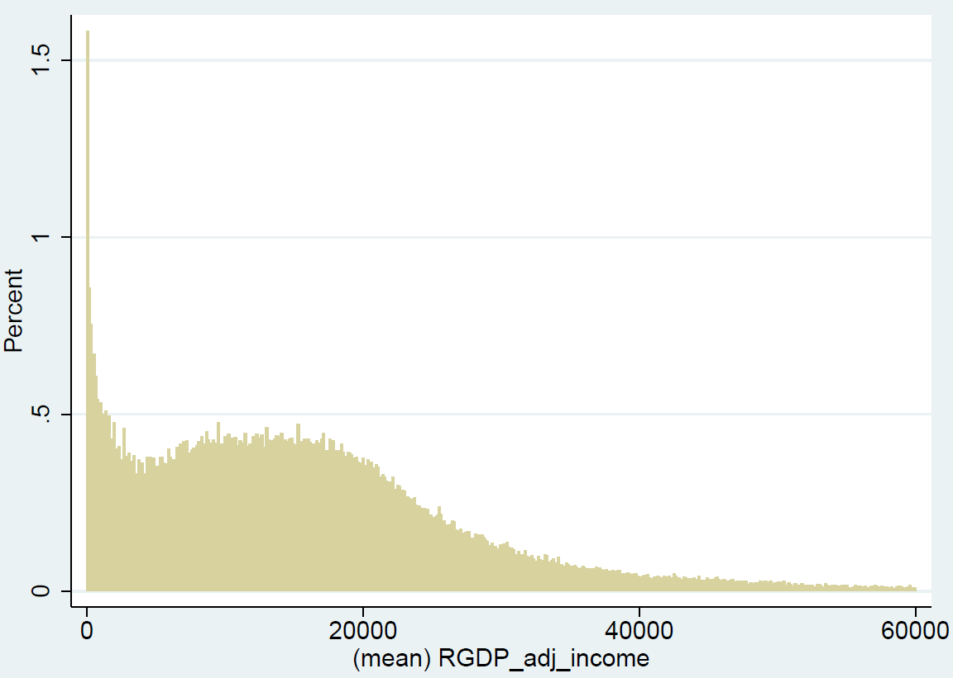
DEPENDENT VARIABLES
Since we have strange frequencies for income values, we decided to remove values below 10.000
for all the three variables. We adjusted for Real GDP the variables “New Wage” and “Income”.
FIRST WAGE
NEW WAGE
INCOME
We only selected people below 30 years because of the high amount of NEETs in Italy
We chose to remove people that never changed jobs and that stayed in the dataset for more than 3 years
We decided to maintain people that remained for more than 3 years
HISTOGRAM OF FIRST WAGE
HISTOGRAM OF NEW WAGE
HISTOGRAM OF INCOME
Notes:
All the distributions should follow the lognormal distribution
le analizziamo per capire come comincia l’income e poi come si evolve
FIRST WAGE
first wage of the person in the sample (sample 2005-2016) → calculate first wage on the mostly likely people to have a first job= below 30
NEW WAGE → people who changed job
analyzing people that changed jobs at least once
adjusted for rgdp and accounted for inflation
more than three yrs bc below that data was inconsistent
INCOME → panel data (we use time come time variable and not month; we can do this because we adjusted for real GDP so we can compare the moment they enter in the dataset even if it is in different yrs)
we consider people to stay in the dataset at least for 36 months
in the histogram we show only up to 60000 euros of income, but in the research we account even for incomes above that level

Slide 4
METHODOLOGY
FIRST WAGE
NEW WAGE
INCOME
Ordinary Least Square (OLS)
Ordinary Least Square (OLS)
POOLED Ordinary Least Square
Analysis Of Variance (ANOVA)
Analysis Of Variance (ANOVA)
Least Squared Dummy Variable (LSDV2) FIXED EFFECTS
HETEROSKEDASTIC
LINEAR REGRESSION (Het Regress with the GLS method)
Least Squared Dummy Variable (LSDV3) FIXED EFFECTS
Generalized Least Squares (GLS ) RANDOM EFFECTS
Notes:
FIRST WAGE
OLS
ANOVA = exclude non categorical variables
het reg → to account for heteroskedastic errors after we saw that heteroskedasticity was very high with a breusch pagan test (can be done with two methods GLS or
NEW WAGE
OLS
ANOVA → abbiamo levato quella variable per capire quanto le altre variabili influenzano new wage
abbiamo la variabile last wage (ultimo stipendio prima di cambiare lavoro o prima di essere empoyed, molto correlata a new wage e spiega la maggior parte della regression)
INCOME
fixed effect lsdv2 = accounting for time
fixed effect lsdv3= accounting time and people
POOLED ordinary least squared - the data are organized differently (by time and individuals)
GLS - to account for heteroskedasticity
Anova stands for analysis of variance, in our case we are using a factorial ANOVA as we have one dependent variable and multiple independent variables. The model is useful in understanding how the mean of each independent variable is different from the other i.e. understanding which independent variable has a connection to our dependent variable.
Like other types of statistical tests, ANOVA, an omnibus test statistics, compares the means of different groups and shows you if there are any statistical differences between the means.
It’s important to remember that the main ANOVA research question is whether the sample means are from different populations. There are two assumptions upon which ANOVA rests:
1. Whatever the technique of data collection, the observations within each sampled population are normally distributed.
2. The sampled population has a common variance of s2.
hetregress fits linear regressions in which the variance is an exponential function of covariates that you specify. It allows you to model the heteroskedasticity. When we fit models using ordinary least squares (regress), we assume that the variance of the residuals is constant. If it is not constant, regress reports biased standard errors, leading to incorrect inferences. hetregress lets you deal with the heterogeneity.
Modeling the variance as an exponential function also produces more efficient parameter estimates if the variance model is correctly specified.
hetregress implements two estimators for the variance: a maximum likelihood (ML) estimator and a two-step GLS estimator. The ML estimates are more efficient than those obtained by the GLS estimator if the mean and variance function are correctly specified and the errors are normally distributed. The two-step GLS estimates are more robust if the variance function is incorrect or the errors are nonnormal.
RE-models determine individual effects of unobserved, independent variables as random variables over time. They are able to “switch” between OLS and FE and hence, can focus on both, dependencies between and within individuals.

Slide 5
REGRESSIONS DESCRIPTION
FIRST WAGE
NEW WAGE
INCOME
Sex
Age Group
Firm Size
Qualification
Type of Contract
Number of Jobs*
Macro Region
Year
Sex
Age Group
Firm Size
Qualification
Type of Contract
Months in Sample at the Time of observation**
Worker ID***
Sex
Age Group
Firm Size
Qualification
Type of Contract
RGDP adj last wage*
FIRST WAGE CONSTRAINTS
NEW WAGE CONSTRAINTS
INCOME CONSTRAINTS
New wage >= 10.000
Number of Jobs >= 2
Years in Sample >= 3
Income >= 10.000
Years in Sample >= 3
first wage >= 10.000
Age < 30
* not present in ANOVA. ** present only in LSDV2, LSDV3, RE. *** present only in LSDV3, RE.

Slide 6
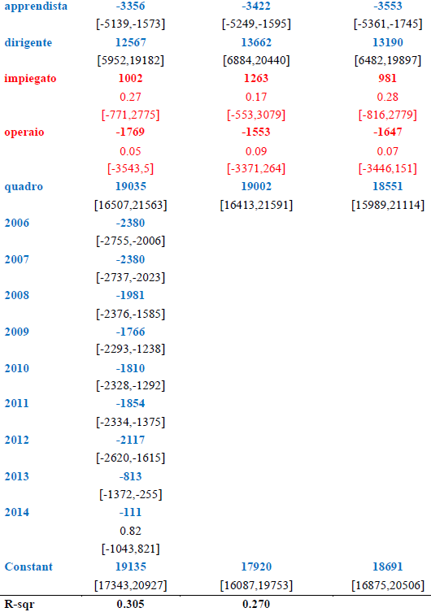
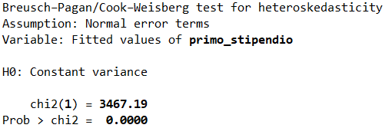
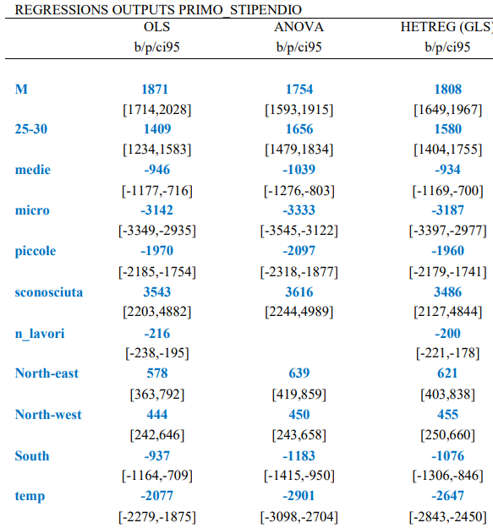
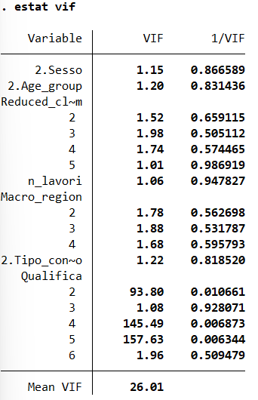
REGRESSIONS: FIRST WAGE

Slide 7
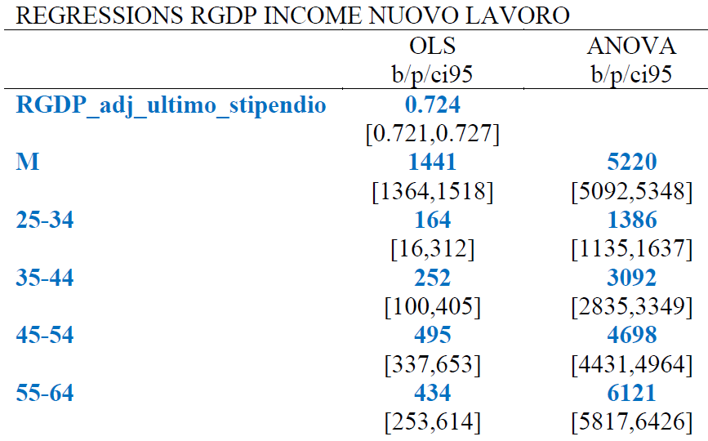
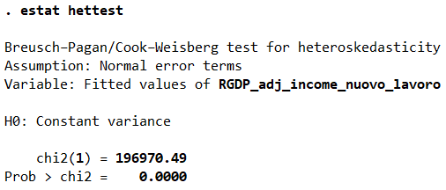
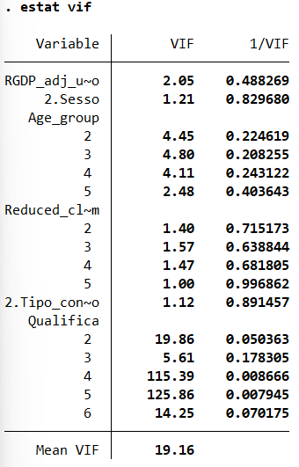
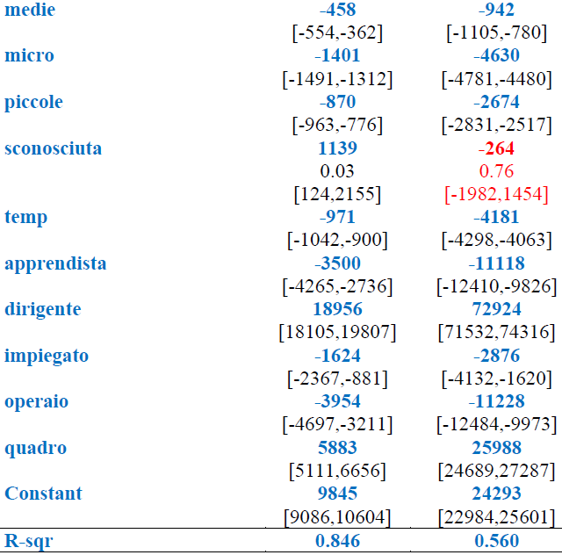
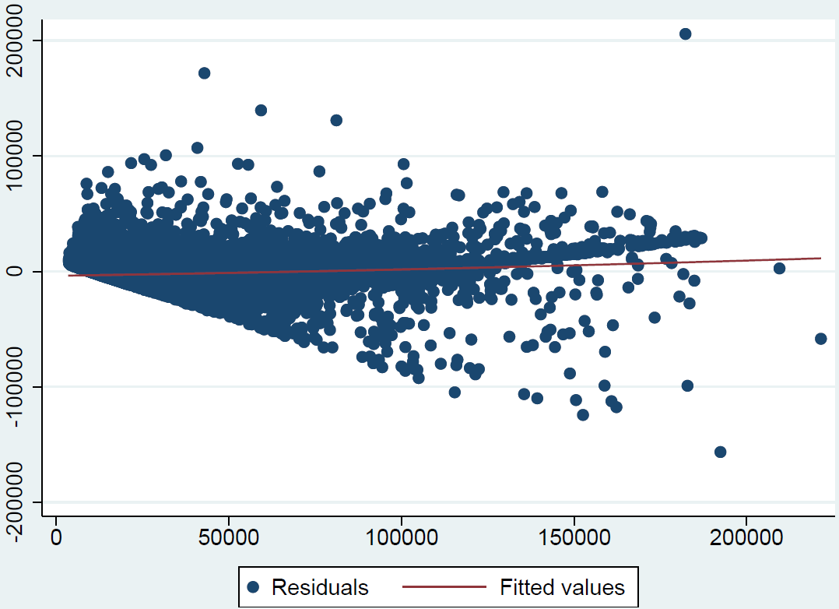
REGRESSIONS: NEW WAGE

Slide 8
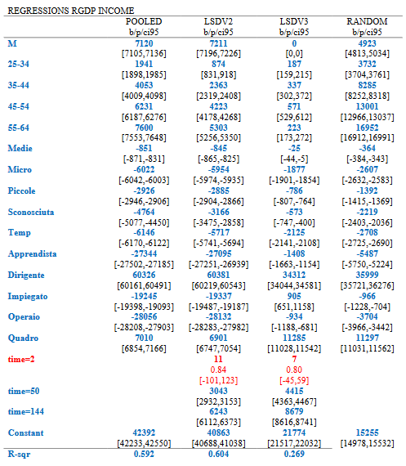
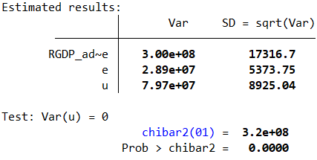

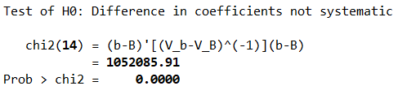
REGRESSIONS: INCOME
RE & POOLED OLS BREUSCH-PAGAN
MULTIPLIER TEST
POOLED OLS & LSDV2
LSDV2 & LSDV3
FE & RE
HAUSMAN TEST
Notes:
F TEST: NULL —> FIXED EFFECTS = 0
y = X’B + U,i + E,it
NULL —> VARIANCE RE = 0
u = RE component
NULL —> COEFFICIENT DIFF = 0
ACCEPT NULL = RE because smaller STANDARD ERRORS
REJECT NULL = FE accounts for OMITTED VAR BIAS at a HIGHER GROUP LEVEL

Slide 9
CONCLUSIONS
Distribution of wages NOT following a log-normal distribution
All regression made have significant variables and relatively very high R squared
Qualification matters the most
Sex, Age, Firm Size, Region, Type of Contract and Time also impact substantially
Multicollinearity because of impiegato, operaio and apprendista
Heteroskedasticity issues, not fully solved by adjusting by Real GDP
New job salary depending on last, but high predictive power even without it
LSDV3 Fixed-Effect used to regress income, omitted variable bias with RE

Slide 10
THANK YOU

